Slide 1

Car Market Trends Analysis with Car Dekho Data
-- Vishnu Bandavath

Slide 2

PROBLEM STATEMENT
Objective
The primary objective of this analysis is to leverage the dataset from Car Dekho to identify trends, patterns, and insights in the car market. This analysis aims to support decision-making for stakeholders such as car manufacturers, dealerships, and potential buyers by providing a comprehensive understanding of the market dynamics.

Slide 3
Project Description: The Car Dekho dataset typically includes various features related to car listings such as: Car Name: Name of the car model Brand: Brand or manufacturer of the car Year: Year of manufacture Selling Price: Price at which the car is being sold Present Price: Current ex-showroom price of the car Kms Driven: Number of kilometers the car has been driven Fuel Type: Type of fuel used by the car (Petrol, Diesel, CNG, etc.) Seller Type: Whether the seller is a dealer or an individual Transmission: Type of transmission (Manual or Automatic) Owner: Number of previous owners Mileage: Fuel efficiency of the car Engine: Engine capacity Power: Power output of the car Seats: Number of seats in the car

Slide 4

End Users in Car Market Trends Analysis Project:
Car Manufacturers
Car Dealerships
Potential Car Buyers
Financial Institutions
Insurance Companies
Government Bodies
Market Analysts

Slide 5

Technology Used:
Jupyter Notebook: Interactive data analysis and visualization.
Python: For data analysis, visualization, and modeling.
Data Analysis Libraries:
Pandas: Data manipulation and analysis.
NumPy: Numerical computing.
Matplotlib: Data visualization.
Seaborn: Statistical data visualization.
Scikit-learn: Machine learning and predictive modeling.

Slide 6
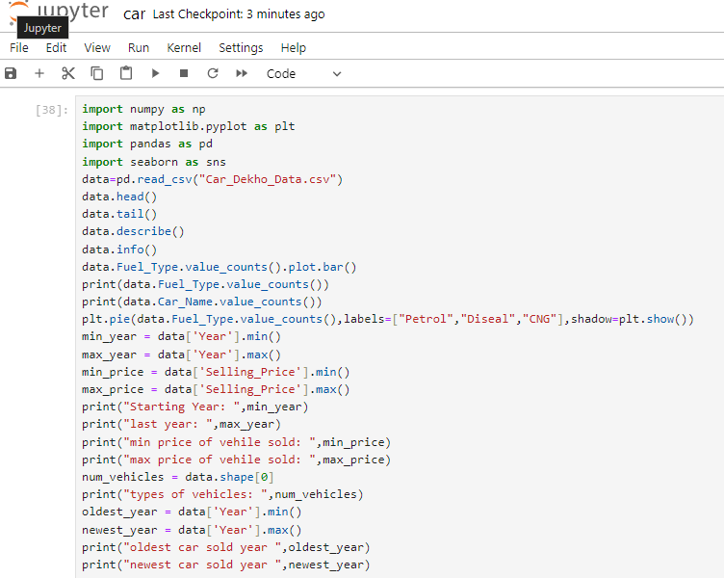
RESULTS

Slide 7
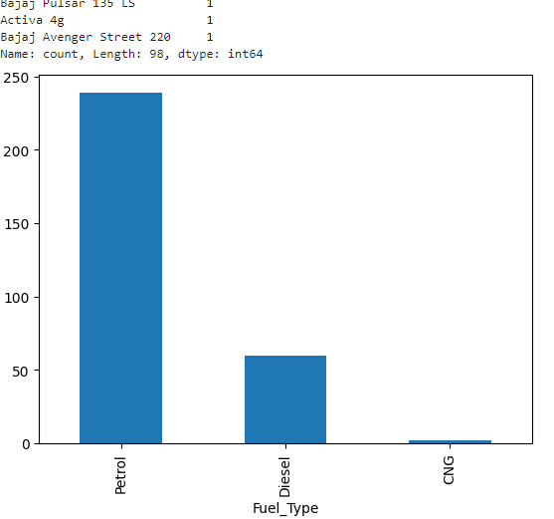
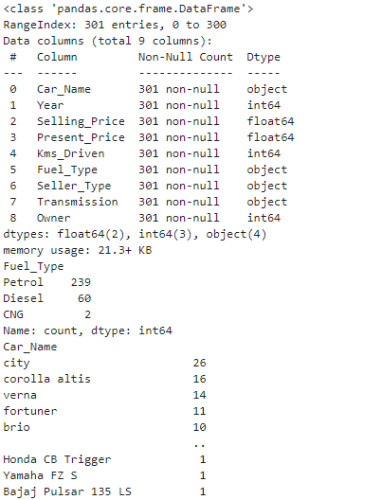
OUTPUT

Slide 8
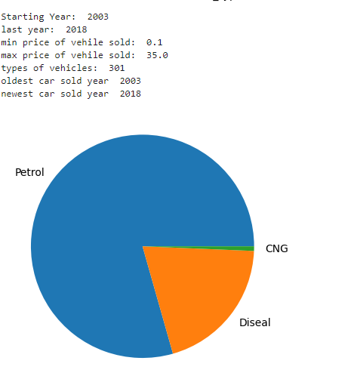
OUTPUT

Slide 9
Thank you
.
.

